Slide 1
Quiz on Lecture 2
Please receive the quiz handout from Cyrille, Oliver, Vincent, Jan
Complete the quiz in silence
Hand the quiz back

Slide 2
Quiz on Lecture 2
Which line defines what the URL for the endpoint will be
  @app.get("/read_root")
  async def read_root():
  “””/read_root”””
  return {"/read_root”}
What is the generally recommended order for the following Dockerfile instructions when building a typical application?
  COPY . . → FROM → WORKDIR → ENTRYPOINT
  FROM → WORKDIR → COPY . . → ENTRYPOINT
  ENTRYPOINT → FROM → COPY . . → WORKDIR
  FROM → COPY . . → WORKDIR → ENTRYPOINT
Which of the following is an analogy for how an API works?
  A chef following a recipe to bake a cake.
  A librarian organizing books on shelves.
  A power outlet providing electricity to an appliance.
  A painter mixing colors on a palette.
What is "REST" in "RESTful API"?
  A contract defining how software components interact
  A specific style of rules/standards for how to build an API
  GET, POST, PUT, DELETE methods
  Locally on AIMS servers
Which of the following is a benefit of using a hypervisor virtualization over Docker containers?
  Faster startup times and lower resource consumption.
  Enhanced application portability and simplified dependency management.
  More efficient sharing of the host operating system kernel.
  More efficient management of the hardware resources

Slide 3
Quiz on Lecture 2 (Answers)
Which line defines what the URL for the endpoint will be
  @app.get("/read_root")
  async def read_root():
  “””/read_root”””
  return {"/read_root”}
What is the generally recommended order for the following Dockerfile instructions when building a typical application?
  COPY . . → FROM → WORKDIR → ENTRYPOINT
  FROM → WORKDIR → COPY . . → ENTRYPOINT
  ENTRYPOINT → FROM → COPY . . → WORKDIR
  FROM → COPY . . → WORKDIR → ENTRYPOINT
Which of the following is an analogy of how an API works?
  A chef following a recipe to bake a cake.
  A librarian organizing books on shelves.
  A power outlet providing electricity to an appliance.
  A painter mixing colors on a palette.
What is "REST" in "RESTful API"?
  A contract defining how software components interact
  A specific style of rules/standards for how to build an API
  GET, POST, PUT, DELETE methods
  Locally on AIMS servers
Which of the following is a benefit of using a hypervisor virtualization over Docker containers?
  Faster startup times and lower resource consumption.
  Enhanced application portability and simplified dependency management.
  More efficient sharing of the host operating system kernel.
  More efficient management of the hardware resources

Slide 4
Designing and Deploying
end-to-end
Production Grade ML Applications
Lecture 3: Software Development Best Practices
October 2025
Cyrille Feudjio & Oliver Angélil

Slide 5
Contents of this lecture
Why Best Practices Matter
Writing Clean & Maintainable Code
Effective Testing Strategies
Version Control & Collaboration
Code Quality Checks
Conclusion & Key Takeaways

Slide 6
1. Why Do Best Practices Matter?
Improved Code Quality & Readability
Enhanced Maintainability & Scalability
Reduced Bugs & Faster Debugging
Easier Onboarding for New Team Members
Better Collaboration
Increased Reliability & Stability

Slide 7
2. Writing Clean & Maintainable Code
Tools: PEP8
PEP8 (Python Enhancement Proposal), is a consensus set of style and formatting rules for writing standard style Python, so your code has the right look for anyone else reading or modifying it.
Some important PEP8 rules are:
Indent 4 Spaces: Indent code with 4 spaces. A def/if/for/while line ends with a colon, and its contained lines begin on the next line, all indented by 4 spaces
Single Space Between Items: Most lines of code have a mix of variables and "operators" such as as + * / = >=. Use a single space to separate the operators and items and operators from each other
Parenthesis No Space: The left and right parenthesis and square brackets do not have spaces separating them from their contents.
Space After Comma/Colon: A comma or colon has 1 space after it, but no spaces before it.

Slide 8
2. Writing Clean & Maintainable Code
Tools: Ruff
Ruff is a fast linter for Python that enforces PEP8 and other code quality rules. It helps Catch syntax errors and enforce PEP8 styling, Identify unused imports and variables.
why ruff?
Speed – Faster than flake8, pylint, black combined. Fast because written in Rust (the "modern C++")
All-in-One – Replaces multiple tools
Highly configurable – Enable/disable specific rules

Slide 9
2. Writing Clean & Maintainable Code
Readability & Naming Conventions
Use Meaningful Names (Variables, Functions, Classes) : Names should convey intent. Descriptive names make your code self-documenting and easier to understand for others (and your future self)
# ❌ Bad: Unclear function and variable names
def f(a, b):
return a**2 * b * 3.14
r = f(7, 10)
# ✅ Good: Names express intent
def calculate_cylinder_volume(radius, height):
PI = 3.14
return radius**2 * height * PI
area = calculate_cylinder_volume(7, 10)

Slide 10
2. Writing Clean & Maintainable Code
Readability & Naming Conventions
Imagine a document where each paragraph uses a different font, indentation, and capitalization. It would be difficult to read.
# ❌ Bad (Not Following PEP 8)
class person:
def __init__(self,name,age):
self.name=name
self.age=age
def Greet(self):print("hi "+self.name)
p=person("Alice",30);p.Greet()
# ✅ Good (following PEP 8)
class Person:
def __init__(self, name: str, age: int):
self.name = name
self.age = age
def greet(self) -> None:
print(f"Hi {self.name}")
p = Person("Alice", 30)
p.greet()

Slide 11
2. Writing Clean & Maintainable Code
Readability & Naming Conventions
Keep Functions/Methods Short & Focused): Functions should do one thing and do it well. Keeping them short and focused makes your code easier to read, test, and maintain.
# ❌ Bad (Does Too Much)
def process_user(user_data):
# Validate input
if "name" not in user_data or "email" not
in user_data:
print("Invalid input")
return
# Format name
full_name = user_data["name"].strip().title()
# Send welcome email
print(f"Sending email to {user_data['email']}")
# Save to database
print(f"Saving {full_name} to database")
# ✅ Good(Split Into Focused Functions)
def validate_user(user_data):
return "name" in user_data and "email" in user_data
def format_name(name):
return name.strip().title()
def send_welcome_email(email):
print(f"Sending email to {email}...")
def save_user_to_db(name):
print(f"Saving {name} to database...")
def process_user(user_data):
if not validate_user(user_data):
print("Invalid input")
return
full_name = format_name(user_data["name"])
send_welcome_email(user_data["email"])
save_user_to_db(full_name)

Slide 12
2. Writing Clean & Maintainable Code
Comments & Documentation
Comment the "Why," Not the "What" (Code should be self-explanatory): Comments should add additional information by explaining why something is done not what the code is doing
# ❌ Bad
# Define a function
def send_email(email):
# Print the email
print(f"Sending to [email}")
# ✅ Good
def send_email(email):
# Temporary solution: Simulate email sending until
# SMTP setup
print(f"Sending to [email}")

Slide 13
2. Writing Clean & Maintainable Code
Comments & Documentation
Keep Comments Minimal but Meaningful: Good comments are short, relevant, and insightful. Avoid adding unnecessary or obvious remarks. Say just enough to add value.
# ❌ Bad
# Define a function to add two numbers
def add(a, b):
# Return the sum
return a + b # Add a and b
# ✅ Good
def add(a, b):
return a + b # Used in multiple modules

Slide 14
2. Writing Clean & Maintainable Code
Comments & Documentation
Importance of READMEs: Your code is only as good as how well others (or future you) can understand and use it. A good README make your project easy to use.
❌ Bad (Missing or Vague README)
# Project
This is my app.
✅ Good (Descriptive & Helpful README)
# TaskTamer
TaskTamer is a minimal app that helps you overcome procrastination using deep work sessions and behavioral nudges.
## Features
- Focus Mode (Pomodoro-style)
- Daily task tracking
- AI motivation prompts
## Getting Started
1. Clone the repo
2. Run npm install
3. Start with npm run dev
## License
MIT

Slide 15
2. Writing Clean & Maintainable Code
Comments & Documentation
Importance of Docstring: Your code is only as good as how well others (or future you) can understand and use it. A good and clear Docstring make your functions easy to use.
# ❌ Bad (No Docstring)
def calculate():
pass
# ✅ Good (Brief & Clear Docstring)
def calculate_interest(amount, rate, years):
"""
Calculate simple interest.
Args:
amount (float): Principal amount
rate (float): Annual interest rate
years (int): Duration in years
Returns:
float: Total interest
"""
return amount * rate * years

Slide 16
2. Writing Clean & Maintainable Code
Comments & Documentation
Documenting Architecture & Design Decisions: Code shows how something works but documentation explains why it was built that way. Clear records of architectural and design decisions help teams stay aligned, onboard new devs faster, and avoid repeating mistakes.
❌ Bad (No Context or Traceability)
# Added Redis
Using Redis for caching.
✅ Good (Structured, Thoughtful)
# ADR 002 – Use Redis for Caching
## Status
Accepted
## Context
The app experiences slow response times due to repeated DB queries for frequently accessed data.
## Decision
We will use Redis to cache frequently accessed user profiles and dashboard stats.
## Alternatives Considered
- Memcached (simpler, but less flexible)
- No cache (poor performance under load)

Slide 17
2. Writing Clean & Maintainable Code
Should a Line Break Before or After a Binary Operator?
In Python code, it is permissible to break before or after a binary operator, as long as the convention is consistent locally
❌ Bad (operators sit far away from their operands)
income = (gross_wages +
taxable_interest +
(dividends - qualified_dividends) -
ira_deduction -
student_loan_interest)
✅ Good (easy to match operators with operands)
income = (gross_wages
+ taxable_interest
+ (dividends - qualified_dividends)
- ira_deduction
- student_loan_interest)

Slide 18
2. Writing Clean & Maintainable Code
Simplicity & Avoiding Duplication
Complexity and repetition increase bugs and reduce agility. Always choose simple solutions that solve the problem clearly and don’t repeat yourself (DRY). Here are the key points:
DRY Principle: Don’t Repeat Yourself
KISS Principle: Keep It Simple, Stupid
Avoid copy-pasting (creates duplicate code)

Slide 19
2. Writing Clean & Maintainable Code
Simplicity & Avoiding Duplication
DRY Principle
# ✅ Good
def _get_current_timestamp():
return datetime.datetime.now().strftime("%Y-%m-%d %H:%M:%S")
def _create_log_entry(level, message):
timestamp = _get_current_timestamp()
return f"[{timestamp}] {level}: {message}"
def log_user_login_event(username):
message = f"User '{username}' logged in successfully."
log_entry = _create_log_entry("INFO", message)
print(log_entry)
def log_error_event(error_code, error_message):
message = f"Code {error_code} - {error_message}."
log_entry = _create_log_entry("ERROR", message)
print(log_entry)
log_user_login_event("Alice_123")
log_error_event("0x503", "Service temporarily unavailable")
# ❌ Bad: timestamp & log_entry are repeated!
def log_user_login_event(username):
timestamp = datetime.datetime.now().strftime("%Y-%m-%d %H:%M:%S")
log_entry = f"[{timestamp}] INFO: User '{username}' logged in successfully."
print(log_entry)
def log_error_event(error_code, error_message):
timestamp = datetime.datetime.now().strftime("%Y-%m-%d %H:%M:%S")
log_entry = f"[{timestamp}] ERROR: Code {error_code} - {error_message}."
print(log_entry)
log_user_login_event("Alice_123")
log_error_event("0x503", "Service temporarily unavailable")

Slide 20
2. Writing Clean & Maintainable Code
Simplicity & Avoiding Duplication
Avoid copy-pasting
# ❌ Bad
def process_data_1(data1):
if len(data1) > 10:
# do some processing
return data1
def process_data_2(data2):
if len(data2) > 10:
# do some processing
return data2
# ✅ Good
def process_data(data):
if len(data) > 10:
# do some processing
return data
process_data(data1)
process_data(data2)

Slide 21

3. Effective Testing Strategies
What Is Testing?
Testing is like double-checking your code to make sure it works as expected before real users try it. Imagine building a LEGO set. You don’t want to find out it’s broken only after you’re done. You test as you go.

Slide 22
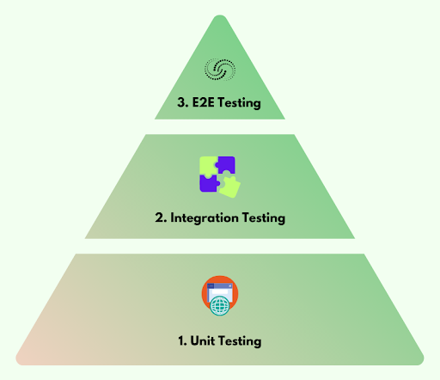
3. Effective Testing Strategies
The Testing Pyramid
The Testing Pyramid is a model for structuring software testing that advocates for a specific distribution of test types. The main idea is to have a large base of fast, low-level Unit Tests, a smaller middle layer of Integration Tests, and a very small top layer of End-to-End (E2E) Tests

Slide 23
3. Effective Testing Strategies
Unit Test
A unit test checks if a small part of your code (like a single function or method) works correctly. You give it an input, and it checks if the output is what you expect.
def multiply(a, b):
return a * b
# Unit Test
def test_multiply():
actual = multiply(2, 3)
expected = 6
assert actual == expected
If the actual is not equal to the expected, the test fails and you know exactly where the problem is.
If someone mistakenly changes the logic in the function, then the test will fail — and for good reason! Because it does not do what is expected.

Slide 24
3. Effective Testing Strategies
Integration Test:
An integration test checks if different parts of your code work together correctly. You’re not testing a single function, you’re testing how two or more components interact.
Suppose you have a login form and a backend function
# Frontend
def login(username, password):
return authenticate_user(username, password)
# Backend
def authenticate_user(username, password):
if username == "admin" and password == "1234":
return "Success"
return "Fail"
# Integration Test
assert login("admin", "1234") == "Success"
This test checks if the login() function (from the frontend) and authenticate_user() (from the backend) work correctly together.

Slide 25
3. Effective Testing Strategies
End-to-End (E2E)
An End-to-End (E2E) test checks if the entire app works from the user's point of view, like clicking buttons, filling forms, and getting expected results. It simulates what a real user does to make sure all parts (frontend, backend, database) are working together. This requires specialized tools such as Selenium, Cypress and Playwright which are outside the scope of this course.
Think of it like walking through the finished LEGO house, checking doors open, windows close, and the roof doesn’t fall off.

Slide 26
3. Effective Testing Strategies
Introducing pytest
Now that we've explained the Testing Pyramid concept, let's introduce a specific tool that can be used to build every layer of it: pytest.
pytest is a modern, powerful, and easy-to-use testing framework for Python
Simple Syntax: Uses the standard assert keyword, making tests clean and readable.
Automatic Discovery: Automatically finds and runs test files (test_*.py) and functions (test_*) with no extra configuration
Powerful Fixtures: A feature for setting up reusable test conditions (like a database connection or a test web client), crucial for complex tests.
Scalable: Perfect for all layers of the pyramid, from tiny unit tests to full end-to-end application tests

Slide 27
3. Effective Testing Strategies
How to Write Tests
The core of writing tests with pytest involves two simple rules:
Test File Naming: Create Python files whose names start with test_ or end with _test.py. For example, test_calculator.py
Test Function Naming: Inside those files, write functions whose names start with test_
Within a test function, you use Python's standard assert keyword to check if a condition is true. If the assertion is true, the test passes. If it's false, the test fails, and pytest will report the error.
Once your test files are set up, running them is straightforward
Open your terminal
Navigate to the root directory of your project
Run the pytest command

Slide 28
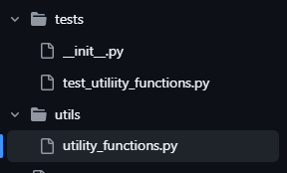
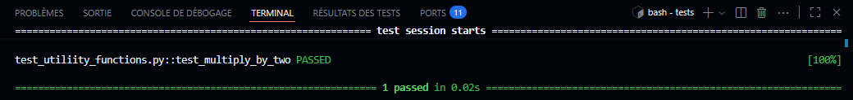
3. Effective Testing Strategies
pytest example
from utils.utility_functions import multiply_by_two
def test_multiply_by_two():
actual_output = multiply_by_two(4)
expected_output = 8
assert actual_output == expected_output
def multiply_by_two(x):
return x * 2

Slide 29
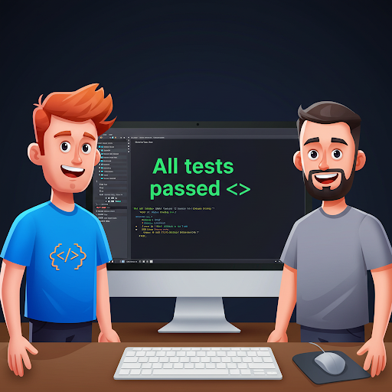
3. Effective Testing Strategies
Why Testing Matters
Helps catch bugs early
Saves time fixing things later
Gives you confidence to change your code without breaking anything
Makes teamwork smoother

Slide 30

3. Effective Testing Strategies
Testing Best Practices
Write Testable Code
Test Early and Often
Use Clear Assertions

Slide 31

4. Version Control & Collaboration
What is Version Control?
Version Control is a system that tracks changes to files over time.
It allows multiple people to work on the same codebase without overwriting each other's work.
Most common system: Git

Slide 32
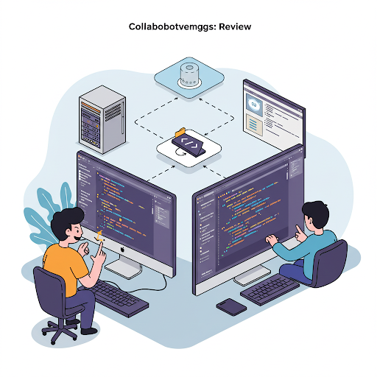
4. Version Control & Collaboration
Why Use Version Control?
Track changes to see who made what change and why.
Easily revert back to previous versions if something breaks.
Collaborate with team members without conflicts.
Backup your work safely in the cloud

Slide 33
4. Version Control & Collaboration
GitHub flow
It is recommended to follow the GitHub flow convention to collaborate on projects
GitHub flow is a lightweight, branch-based workflow. The GitHub flow is useful for everyone, not just developers. To follow GitHub flow, you will need a GitHub account and a repository.
Here are the steps to follow:
Create a feature branch (e.g. feature-branch-cyrille)
Make changes in your branch
Create a pull request
Address review comments
Merge your pull request
Delete your feature branch

Slide 34
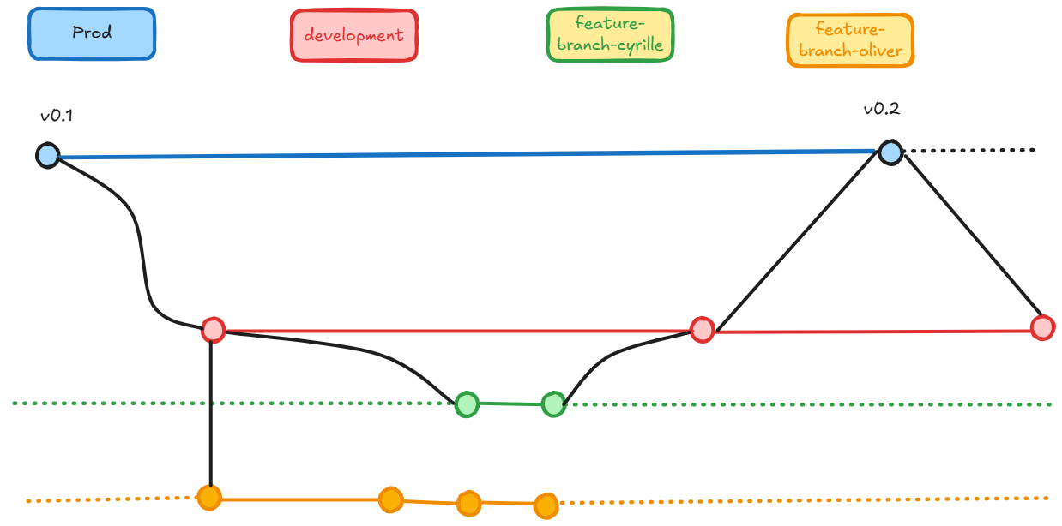
4. Version Control & Collaboration
Git Workflow Example

Slide 35
4. Version Control & Collaboration
Common Git Commands
git status – Show the working tree status
git clone – Copy a remote repository locally
git checkout -b – Create and switch to a new branch
git add . – Add all changes to the staging area
git commit -m "my message" – Save your changes with a message
git push – Send your changes to the remote repository
git pull – Fetch and merge updates from the remote
git merge – Combine branches

Slide 36
4. Version Control & Collaboration
Best Practices for Collaboration
Commit often: Small, meaningful commits help track progress.
Use meaningful commit messages: Explain what and why you changed.
Pull regularly: Stay up to date with the latest changes.
Test before pushing: Avoid pushing broken code.
Pull Requests (PRs): Always get feedback before merging
Keep PRs focused: Generally, try not to change hundreds of lines in one PR. Rather keep them small & focused

Slide 37
5. Code Quality Checks
Tools: UV
The tools used to build, manage, and refine Python projects are constantly improving, with a strong trend towards speed, better integration, and enhanced developer experience. Let's look at some key shifts:
  Package Management & Environment Setup
    Classic Approach:
      pip: The foundational package installer for Python.
      venv / virtualenv: Standard tools for creating isolated environments.
    Modern Successor: uv
    Why the Shift? An extremely fast, all-in-one package resolver and installer, written in Rust.
    Key Benefits:
      Speed: Orders of magnitude faster than pip (10-100x).
      Integrated: Combines functionalities of pip, venv, and more into a single tool.
      Drop-in Potential: Designed to be a largely drop-in replacement for pip

Slide 38
5. Code Quality Checks
Tools: Ruff
Linting & Formatting
Classic Approach:
  Flake8: A popular wrapper combining PyFlakes (error checking), pycodestyle (style checking - PEP 8)
  Black: Code formatter
  isort: For sorting imports
Modern Successor: Ruff
  Why the Shift? An extremely fast linter AND formatter, written in Rust.
  Key Benefits:
    Speed: 10-100x+ faster than Flake8 and other individual tools.
    All-in-One: Can replace Flake8 (and many of its plugins), Black, isort and more.
    Auto-fixes: Powerful and fast automatic fixing of many issues.
    Growing Ecosystem: Rapidly gaining adoption and expanding its rule set.

Slide 39
5. Code Quality Checks
Tools: Pyright
Static Type Checking for type violations
  Established Player:
    Mypy: The original and widely adopted static type checker for Python.
  Modern Successors: Pyright:
  Why the Shift? Developed by Microsoft (powers Pylance in VS Code), known for excellent performance, especially in editor integrations.
  Key Benefits: Fast, strong type inference, excellent IDE support.

Slide 40
5. Code Quality Checks
Instead of manually checking code every time you or your teammates make changes, you can use a pipeline to automatically review and enforce quality whenever someone:
Pushes new code
Opens a pull request
Tries to deploy
This saves time, prevents mistakes, and keeps the project clean and consistent.
For example, you can setup your pipeline to:
Lint the code (e.g., Ruff)
Check types (e.g., Pyright)
Run tests (e.g. Pytest)

Slide 41
5. Code Quality Checks
Linting & Type Checking
Linting checks your code for formatting, style, and simple logic errors
Type checking verifies that you're using the correct data types (e.g., str, int, list) , before you even run the code.
# ❌ Bad (before Ruff)
def hello( name ):
print(f"Hello {name}")
# ✅ Good (after Ruff)
def hello(name):
print(f"Hello {name}")
# ❌ Bad (before Pyright)
def greet(name):
return name + 2 # Adding int to str: Type Error!
# ✅ Good (after Pyright)
def greet(name: str) -> str:
return name + "!"

Slide 42
Practical case
Identifying and Fixing PEP 8 Violations in Python Code
https://gist.github.com/cyrille-feu/e4c8ee733b32dbfcb83bd6af98e8089a
You can use the command below to verify that the changes you have made are correct and compliant with pep8. This command is written with the assumption that you created the file pep8_violations_example.py in your student folder src/students/$GITHUB_USER/
$ uv run ruff check src/students/$GITHUB_USER/pep8_violations_example.py

Slide 43
6. Conclusion & Key Takeaways
Investing in best practices isn't just about following rules. It's the foundation of professional, scalable, and successful software development. It's what separates a short-term project from a long-term, maintainable product.
Your primary audience isn't the computer; it's the next developer (which might be you). Prioritize clarity, simplicity, and meaningful names. Clean code is easier to debug, maintain, and extend.
Don't just hope your code works, prove it. A solid testing strategy (using tools like Pytest) gives you the confidence to make changes without breaking existing functionality
Version control is non-negotiable. Use a structured workflow with clear branches, small pull requests, and descriptive commit messages to work effectively
Automate everything you can. for example Llints (Ruff), type-checks (Pyright), and tests your code on every push is your best defense against human error and ensures consistent quality

Slide 44
Q&A
Questions?

